Slide 1
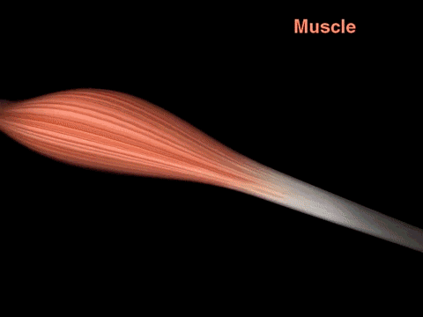
Muscles
AEHBY ATAR Human Biology

Slide 2
Review
Draw three types of muscle tissue. For each, classify them as voluntary or involuntary and give an example of location within the body.
Explain the difference between excretion and elimination.
Describe the structure of the walls of arteries, veins and capillaries.

Slide 3
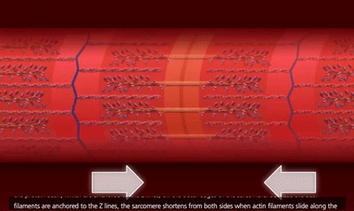
Learning Intentions
The muscular system is organised to maintain posture and produce movement; muscle fibre contraction can be explained using the sliding filament theory.

Slide 4
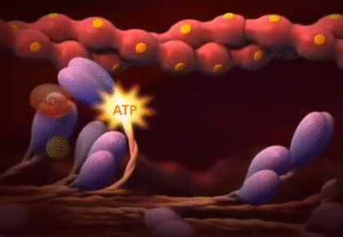
Success Criteria
Describe the structure of the muscle (in terms of bundles)
Describe the structure of the filament including bands, lines and zones.
Describe what happens to the filament during stretching, relaxing or contraction.

Slide 5
Muscles
Muscle tissues are contractable (can shorten their length), extensible (able to be stretched, although they can’t stretch themselves) and elastic (return to original length after being stretched).

Slide 6
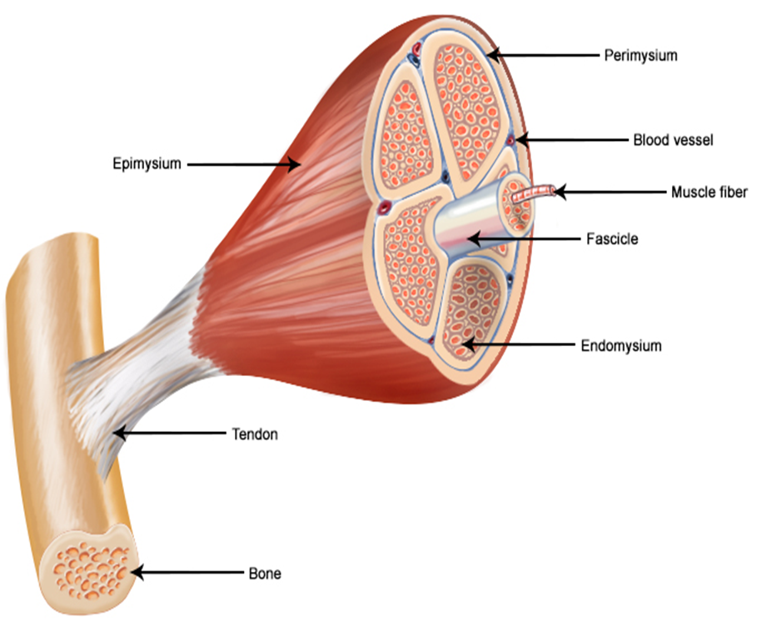
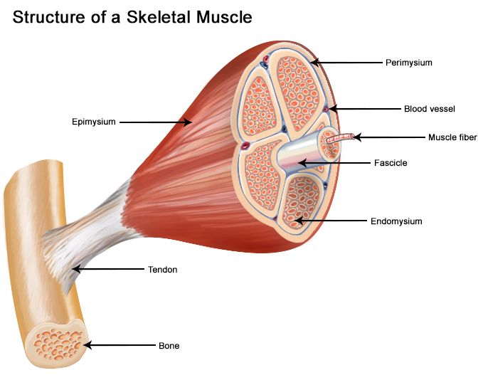
Structure of muscles
Each muscle is made up of groups of muscle fibres called fascicles surrounded by a connective tissue layer called perimysium. Multiple units of individual muscle fibres within each fascicle are surrounded by endomysium, a connective tissue sheath.

Slide 7
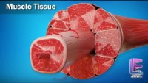

Slide 8
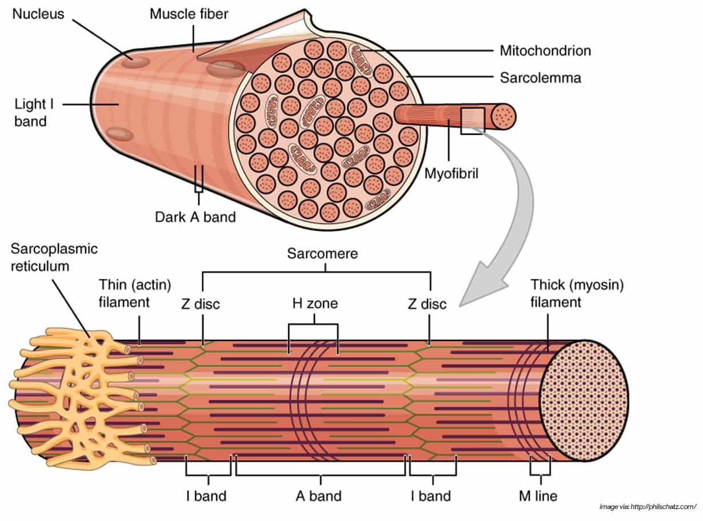
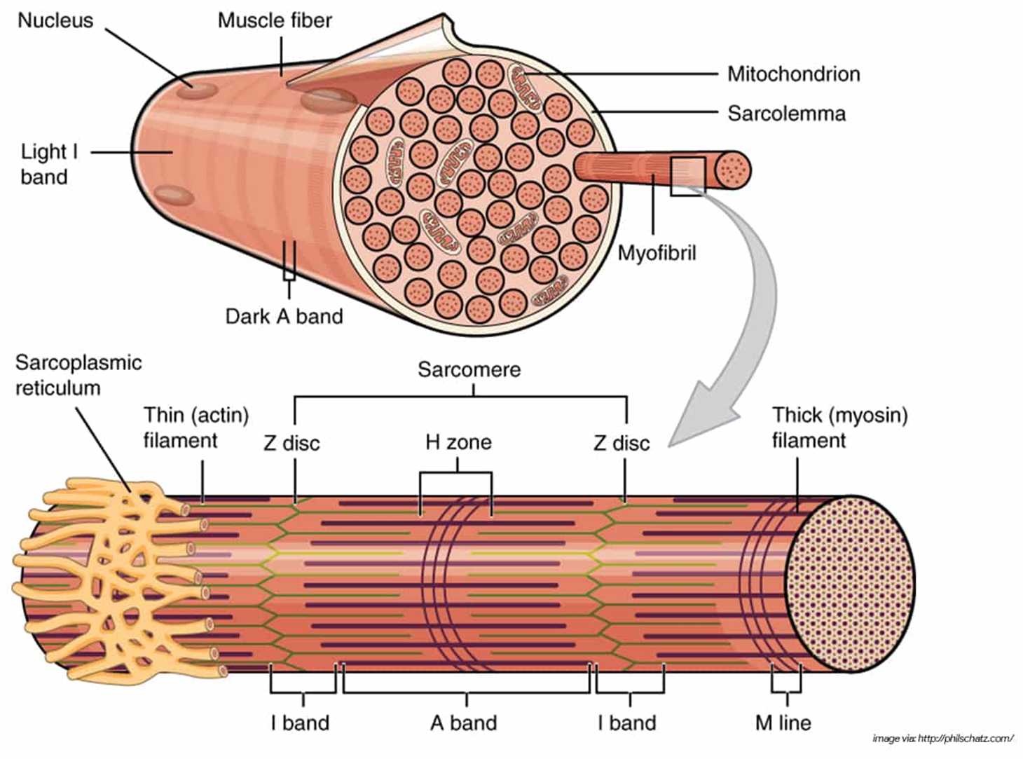
Structure of skeletal muscle

Slide 9
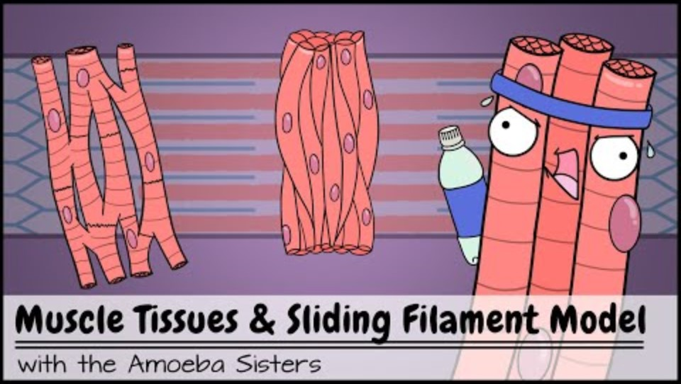

Slide 10
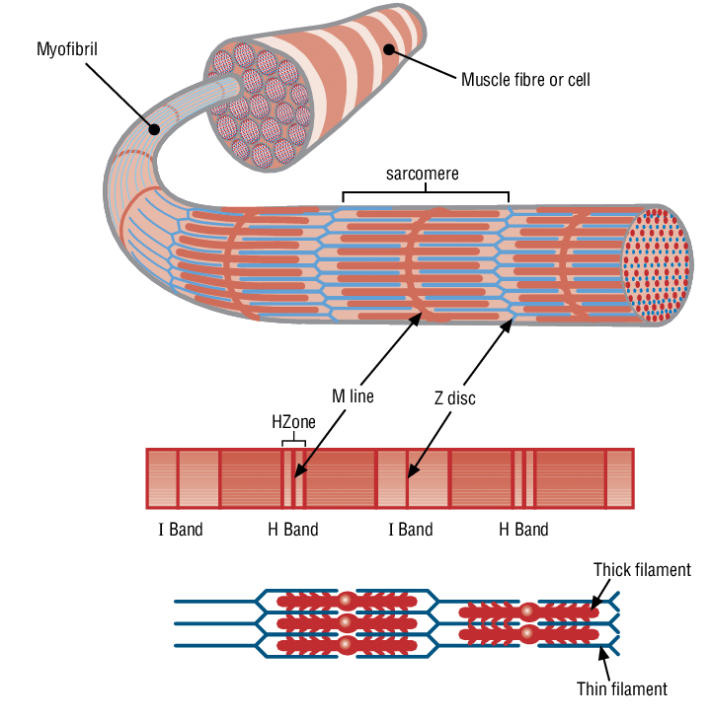

Slide 11
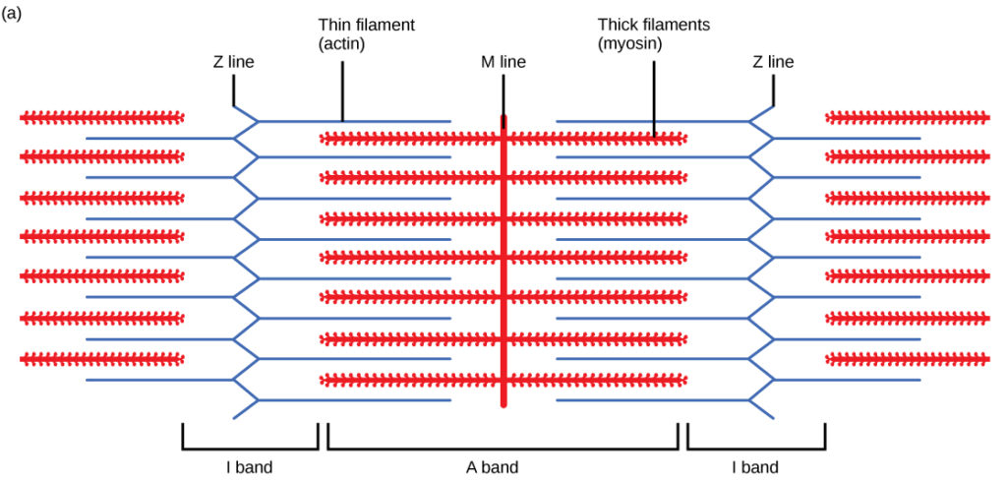

Slide 12
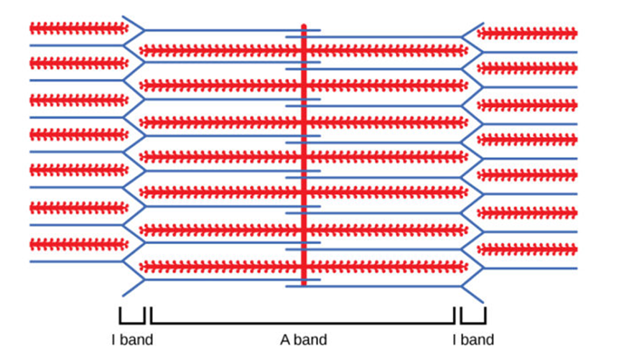

Slide 13
Success Criteria
Describe the structure of the muscle (in terms of bundles)
Describe the structure of the filament including bands, lines and zones.
Describe what happens to the filament during stretching, relaxing or contraction.

